Slide 1
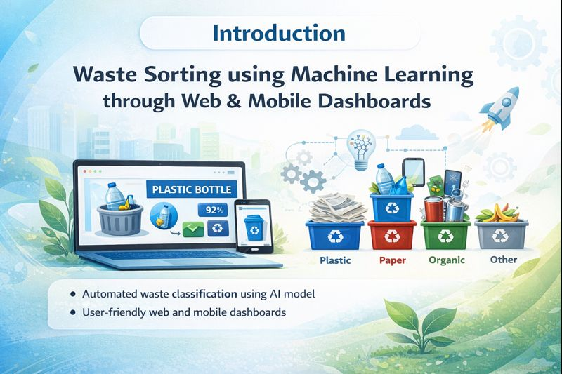
Waste Sorting Dashboard & Mobile Integration using Machine Learning
BY
GOKUL S
255214344
M. Sc. Computer Science – ‘C’

Slide 2
Introduction
Waste management is a major challenge in smart cities
Manual waste segregation is:
Time-consuming
Error-prone
Inefficient
Machine learning can automatically classify waste
Dashboards and mobile apps help visualize results in real time
👉 This project combines ML + web/mobile UI

Slide 3
Problem Statement
Improper waste segregation leads to:
Environmental pollution
Low recycling efficiency
Lack of smart monitoring systems
No real-time feedback to users
Problem: ❌ No intelligent system to classify waste and guide disposal

Slide 4
Objectives
To classify waste using Machine Learning
To integrate ML output into a web dashboard
To support mobile-based waste monitoring
To recommend correct waste bins automatically
To deploy the system for real-time use

Slide 5
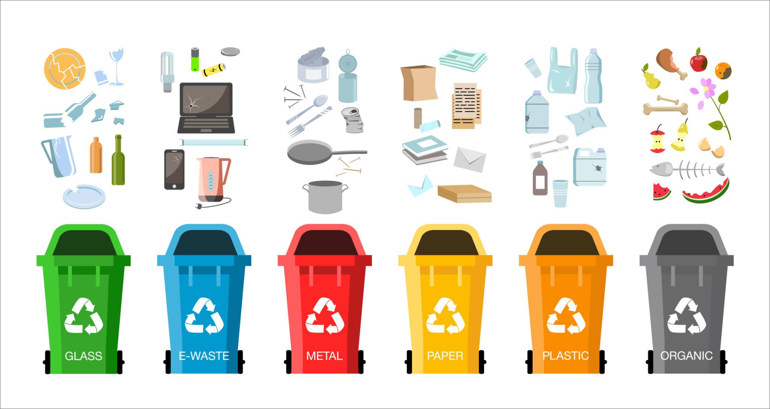
Types of Waste Considered
Plastic waste
Paper waste
Metal waste
Organic (wet) waste
(Optional) E-waste
👉Each type is mapped to a specific bin color

Slide 6
Technology Stack
Machine Learning
Python
TensorFlow
CNN (MobileNetV2)
Backend
Flask (REST API)
Frontend
HTML
CSS
JavaScript
Tools
VS Code
Jupyter Notebook
Web Browser / Mobile Web

Slide 7
User Image (Camera / Upload)
Machine Learning Model
Prediction Output (Waste Type + Confidence)
Flask API (JSON Response)
Web / Mobile Dashboard

Slide 8
Machine Learning Model
Uses Convolutional Neural Network (CNN)
Pretrained MobileNetV2
Accepts image input (224 × 224)
Outputs:
Predicted waste type
Confidence percentage
Why MobileNetV2?
Lightweight
Fast
Suitable for real-time applications

Slide 9
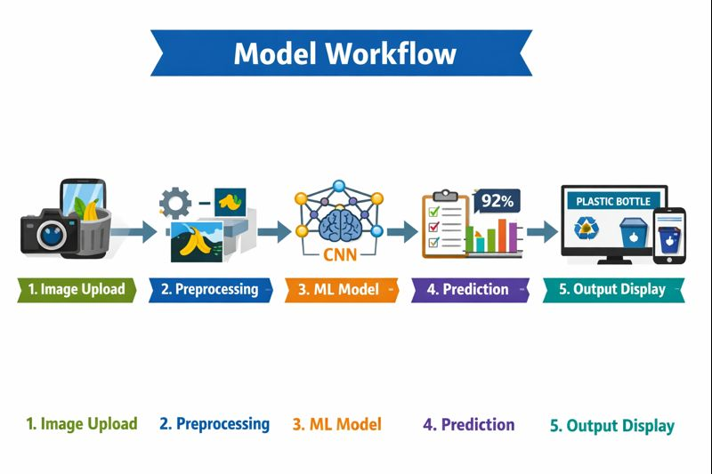
Model Workflow
Image is uploaded by user
Image is resized and preprocessed
Model predicts waste category
Output is generated with confidence score
Result is sent to dashboard

Slide 10
Flask Backend (API Layer)
Flask is used to create a REST API
Endpoint:
POST /predict
Accepts image as input
Returns output in JSON format
Example Response:
{
"waste_type": "plastic bottle",
"confidence": 92.4}

Slide 11
Embedding ML Output into UI
Frontend sends image using fetch()
Flask API returns JSON response
JavaScript reads:
waste_type
Confidence
UI dynamically updates:
Waste name
Confidence
Bin color

Slide 12
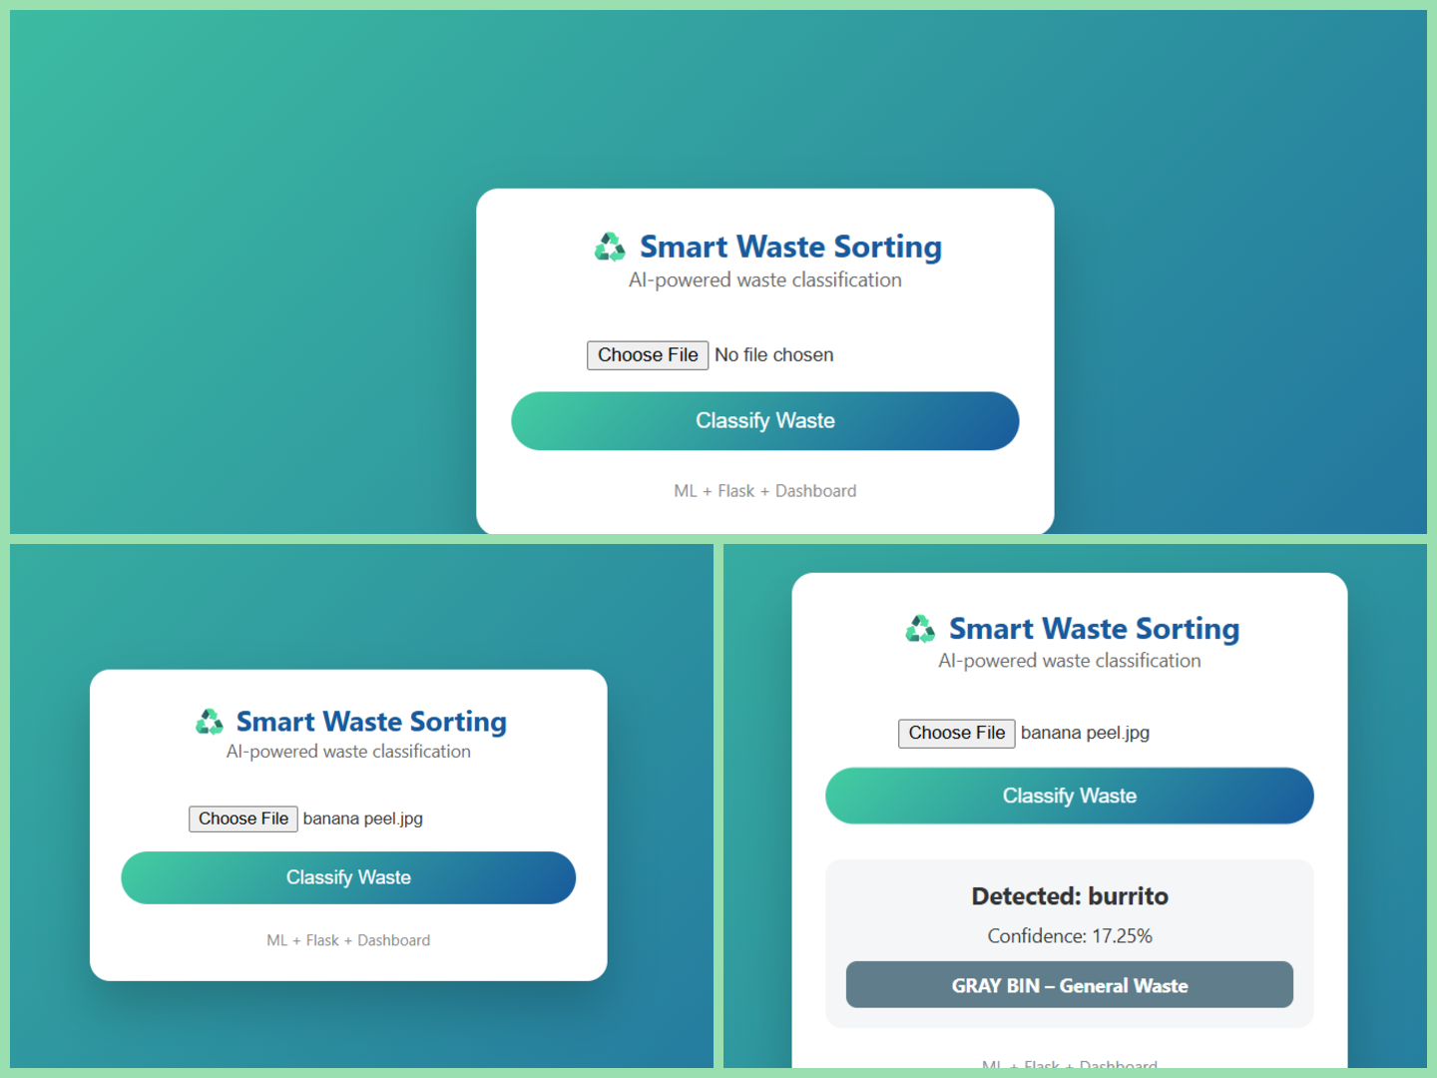
Web Dashboard UI
Features:
Image upload
Classification button
Waste type display
Confidence score
Bin recommendation
Benefits:
User-friendly
Real-time updates
Responsive (mobile-friendly)

Slide 13
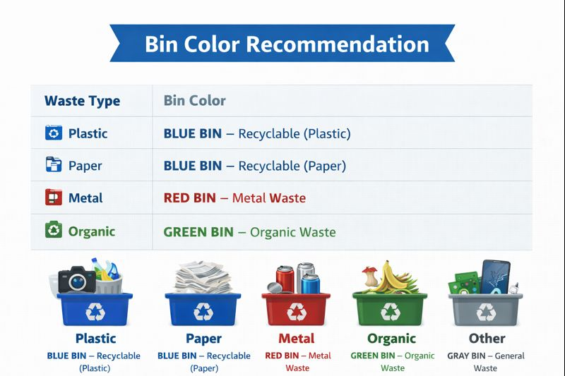
Bin Recommendation Logic
Waste Type: | Bin Color | Description
Plastic | Blue 🟦 | Recyclable plastic waste
Paper | Blue 🟦 | Recyclable paper waste
Metal | Red 🟥 | Metal cans and tins
Organic | Green 🟩 | Food and biodegradable waste
Other | Gray ⬜ | Non-recyclable waste
This logic is implemented in JavaScript.

Slide 14
Advantages Limitations
Automated waste classification
Reduces human error
Improves recycling efficiency
Scalable system
Supports smart city initiatives
Depends on image quality
Limited waste categories
Requires internet for deployment
Accuracy depends on training data

Slide 15
Applications Future Enhancements
Smart cities
Municipal waste management
Public waste bins
Educational institutions
Recycling plants
Custom waste dataset training
Real-time camera integration
IoT-enabled smart bins
Waste analytics dashboard
Cloud-based large-scale deployment

Slide 16
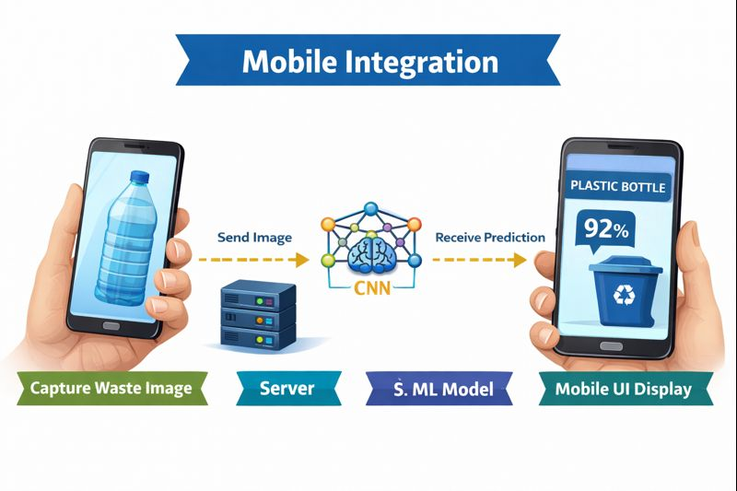
Conclusion
Machine learning enables intelligent waste sorting
Web and mobile dashboards improve usability
The system provides:
Real-time classification
User guidance
Efficient waste management
Suitable for real-world and academic use

Slide 17
Any Questions
THANK YOU

